Slide 1



EV Charging Demand Prediction

Slide 2

Learning Objectives
1. Understand the Importance of Predicting EV Charging Demand
Recognize why forecasting is critical for grid reliability, infrastructure planning, and EV adoption.
2. identify Key Factors That Influence Charging Demand
Learn how temporal, spatial, and behavioral data affect usage patterns.
3. Explore Data Sources and Modeling Techniques
Get familiar with the types of data used and common predictive models (e.g., time series, machine learning).
4. Evaluate Model Performance and Interpretation
Understand key metrics for assessing forecast accuracy and how to interpret results.
5. Apply Insights to Real-World Use Cases
Learn how predictions can guide infrastructure placement, grid load balancing, and policy-making.
GOAL
Source :
www.freepik.com/

Slide 3
Tools and Technology used
Data Handling
Python (pandas, NumPy)
SQL / Cloud Storage (AWS, GCP)
Modeling
scikit-learn, XGBoost
Time Series: ARIMA, Prophet
Deep Learning: TensorFlow / Keras (LSTM)
Visualization
Matplotlib, Seaborn, Plotly
Tableau / Power BI
Deployment
Flask / FastAPI
Docker (optional)

Slide 4
Methodology
1. Data Collection
Gather historical charging data, weather, traffic, and location data
2. Data Preprocessing
Clean, normalize, and handle missing values ,Time series aggregation (e.g., hourly/daily demand)
3. Feature Engineering
Temporal: time of day, day of week, holidays
Spatial: station location, urban vs. rural
Environmental: temperature, weather
4. Model Selection
Time Series Models (ARIMA, Prophet)
Machine Learning (XGBoost, Random Forest)
Deep Learning (LSTM for sequential data)
5. Model Training & Evaluation
Train/test split, cross-validation
Evaluate using MAE, RMSE, R²
6. Forecasting & Visualization
Predict future charging demand ,Visualize trends for decision-making

Slide 5
Problem Statement:
As electric vehicle (EV) adoption grows rapidly, existing charging infrastructure faces increasing strain.
Without accurate demand forecasting, cities and utility providers risk:
Overloaded charging stations
Underutilized infrastructure investments
Grid instability during peak hours

Slide 6
Solution:
1. Collect and integrate multi-source data
Charging station logs, weather, traffic, location
2. Apply machine learning and time series models
Use ARIMA, XGBoost, or LSTM to capture patterns and trends
3. Generate accurate demand forecasts
Predict demand at specific times and locations
4. Enable smarter infrastructure planning
Optimize charger placement, grid load balancing, and energy distribution

Slide 7
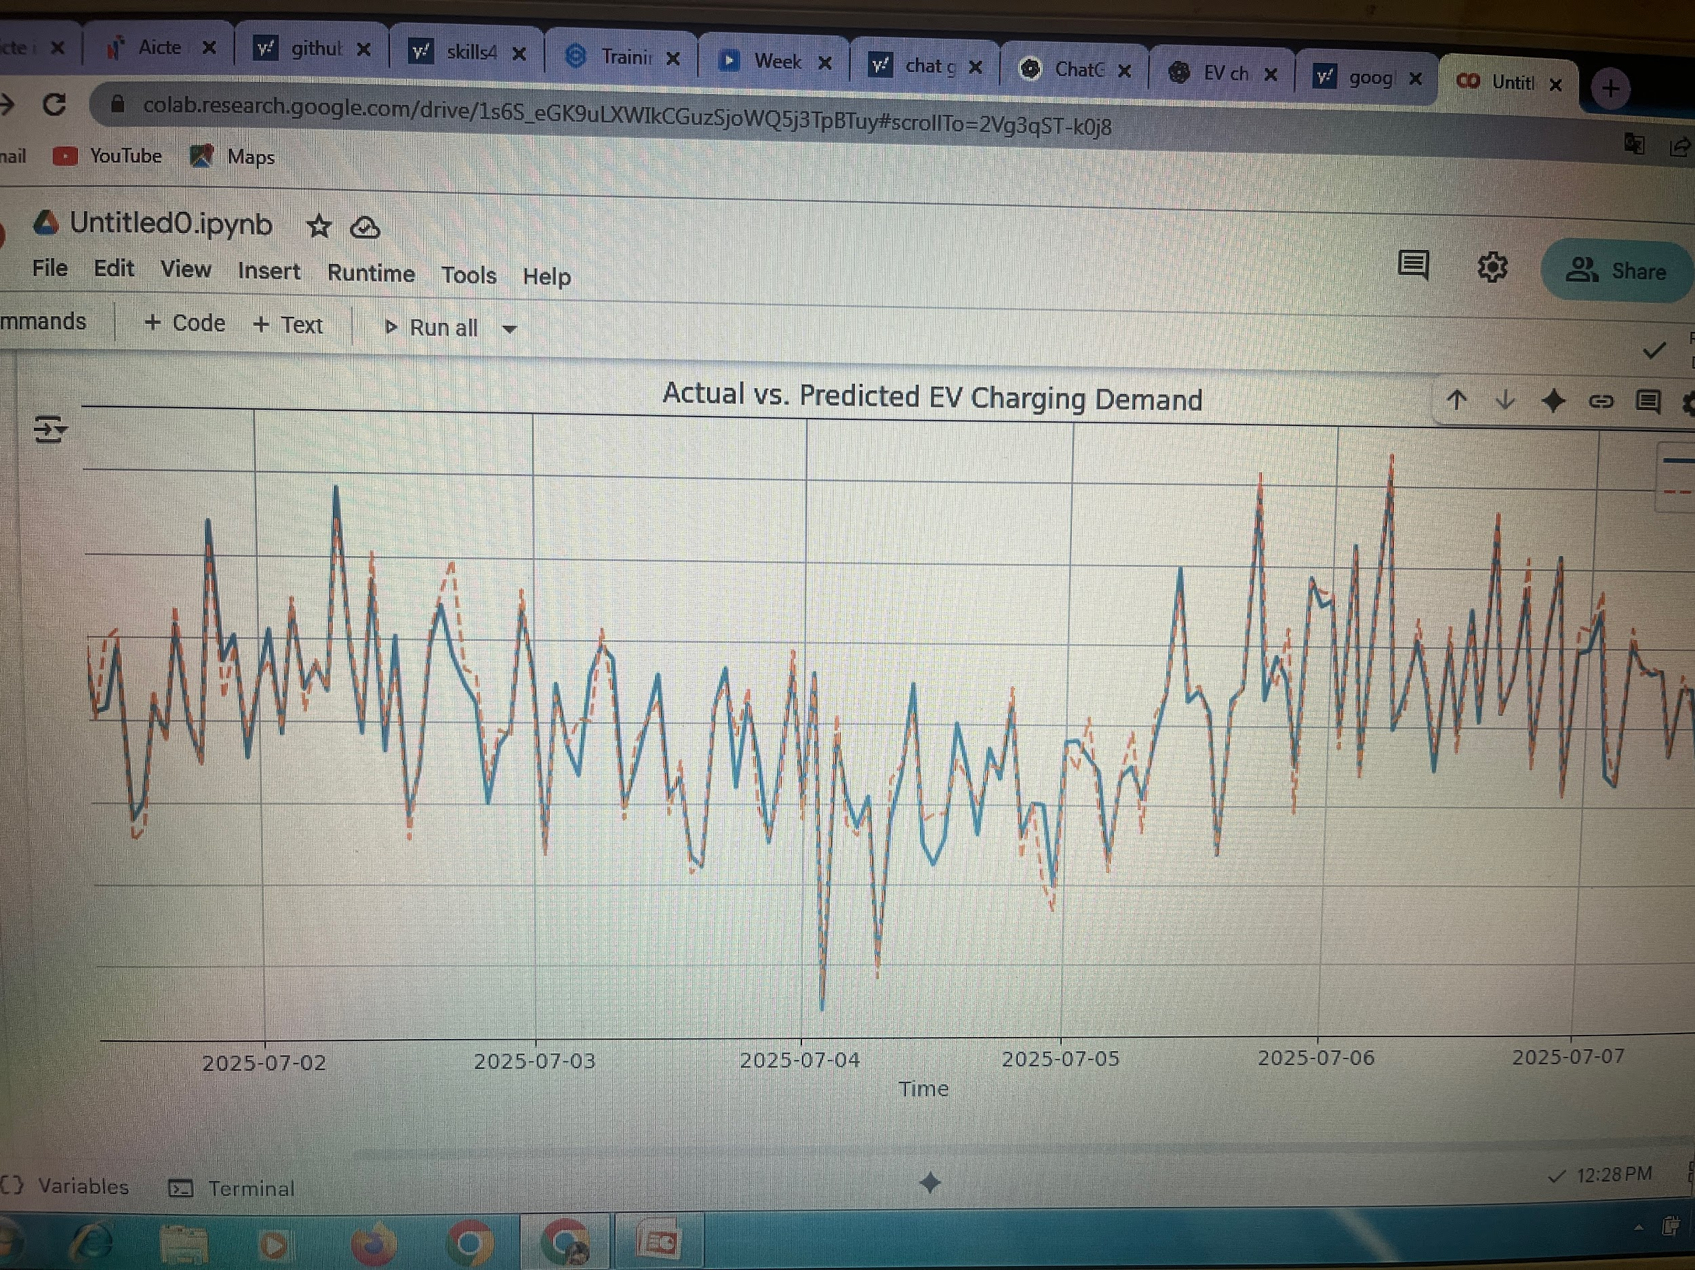
Screenshot of Output:

Slide 8
Conclusion:
Accurate EV charging demand prediction is essential for efficient infrastructure planning, grid management, and resource optimization.
Data-driven forecasting models (like time series and machine learning) provide valuable insights into future demand patterns.
Key Benefits:
Optimizes charging station placement
Ensures grid stability
Reduces costs for infrastructure investment and maintenance
Future Considerations:
Incorporating real-time data for dynamic forecasting
Expanding to include vehicle-to-grid (V2G) interactions

